Slide 1
Residual Network
POSTECH A.I
Jaeseung Heo
Slides provided by Seungbeom Lee

Slide 2
Table of Contents
ResNet
Review the key points
Practice

Slide 3
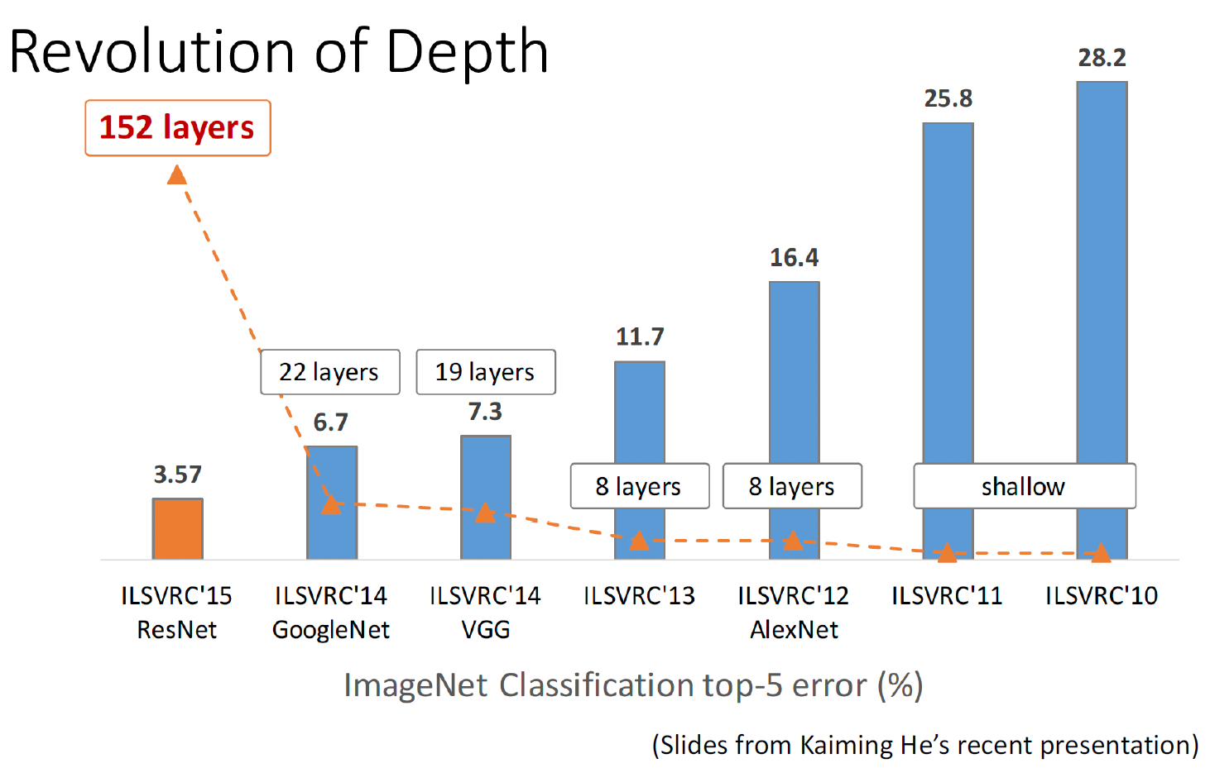
Review the key points
Kaiming He, Xiangyu Zhang, Shaoqing Ren, & Jian Sun.
Deep Residual Learning for Image Recognition. CVPR 2016.

Slide 4
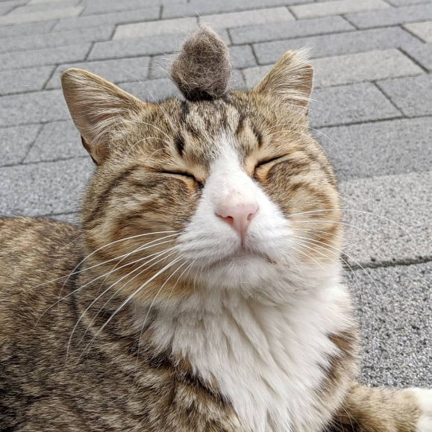
Review the key points
Parameter
Variables that represent the characteristics of the data
Models with more parameters have a larger presentation power.

Slide 5
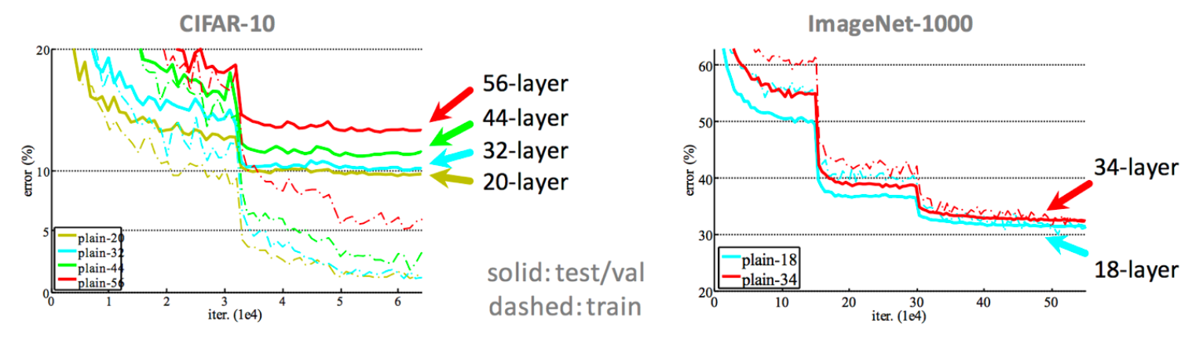
Review the key points
Kaiming He, Xiangyu Zhang, Shaoqing Ren, & Jian Sun.
Deep Residual Learning for Image Recognition. CVPR 2016.
Notes:
너무 많은 layer를 그냥 쌓았을 때는 오히려 training error가 높아지는 현상이 관측됨 (특정 데이터에서가 아닌 많은 데이터에서 일반적으로 관측되는 현상)

Slide 6
Review the key points
Notes:
이론적으로는 deeper model이 higher training error를 가져서는 안됨 (shallow 모델의 layer를 그대로 복제하고 나머지 extra layer가 identitiy layer가 되면 적어도 error가 같아져야 함)
Layer가 깊어질수록 optimizatio이 잘 되지 않음

Slide 7
Review the key points
Notes:
이론적으로는 deeper model이 higher training error를 가져서는 안됨 (shallow 모델의 layer를 그대로 복제하고 나머지 extra layer가 identitiy layer가 되면 적어도 error가 같아져야 함)
Layer가 깊어질수록 optimizatio이 잘 되지 않음

Slide 8
Review the key points
Motivation
Neural networks would be able to learn identity F(X) = X easily
Deep neural networks should perform well at least the swallow model
Notes:
밑에 그림 으로 설명해주귀

Slide 9
Review the key points
Main idea : Makes residual blocks with the identity mappings.

Slide 10
Review the key points
Residual block
Identity block

Slide 11
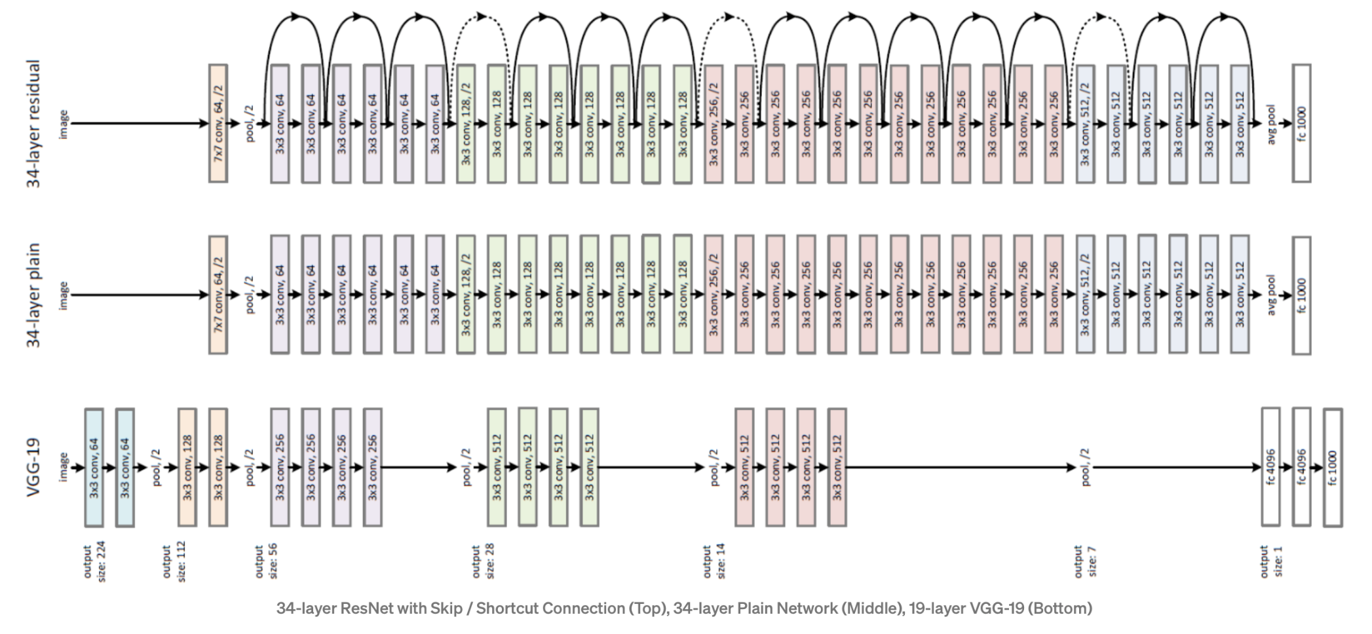

Review the key points
Natural Question
X must be the same size with F(X)
F(X) + $W_{x}$ X

Slide 12
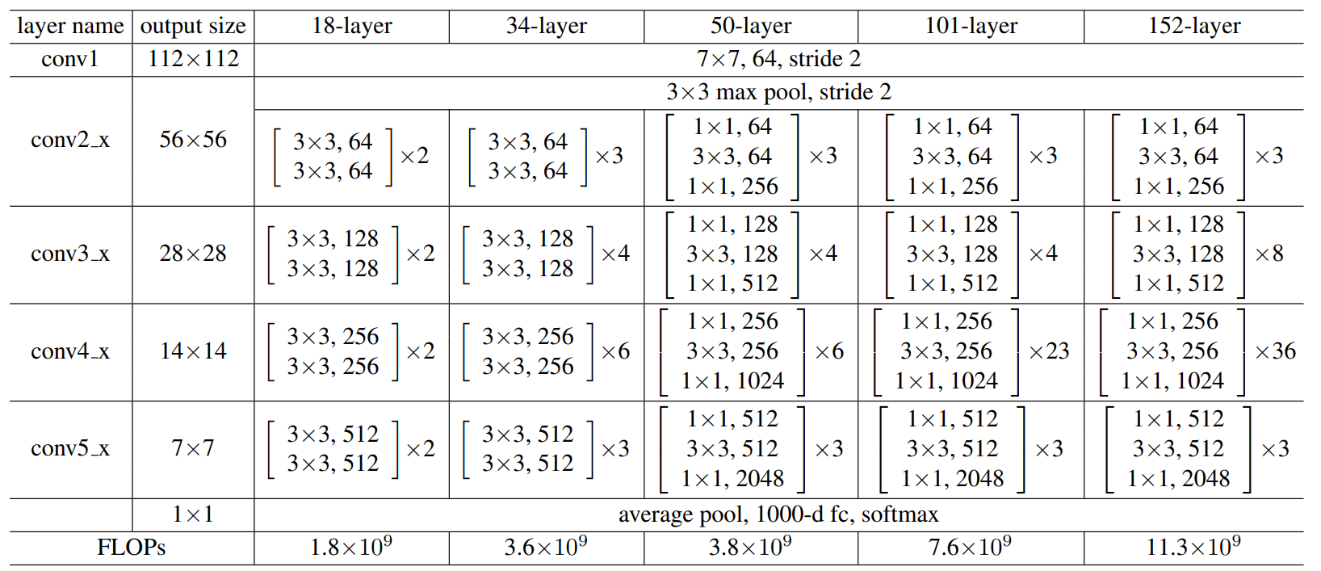
Review the key points
The only thing we do is make the residual blocks
Example
Notes:
1 + 4 + 6 +10 + 4

Slide 13
Table of Contents
CNN
Review the key points
Practice
ResNet
Review the key points
Practice

Slide 14
Practice
ResNet-18 구현해보기

Slide 15
Reference
Goodfellow, I., Bengio, Y., Courville, A.: Deep Learning. MIT Press (2016). http://www.deeplearningbook.org

Slide 16
Thank You :)
jsheo12304@postech.ac.kr

